Slide 1
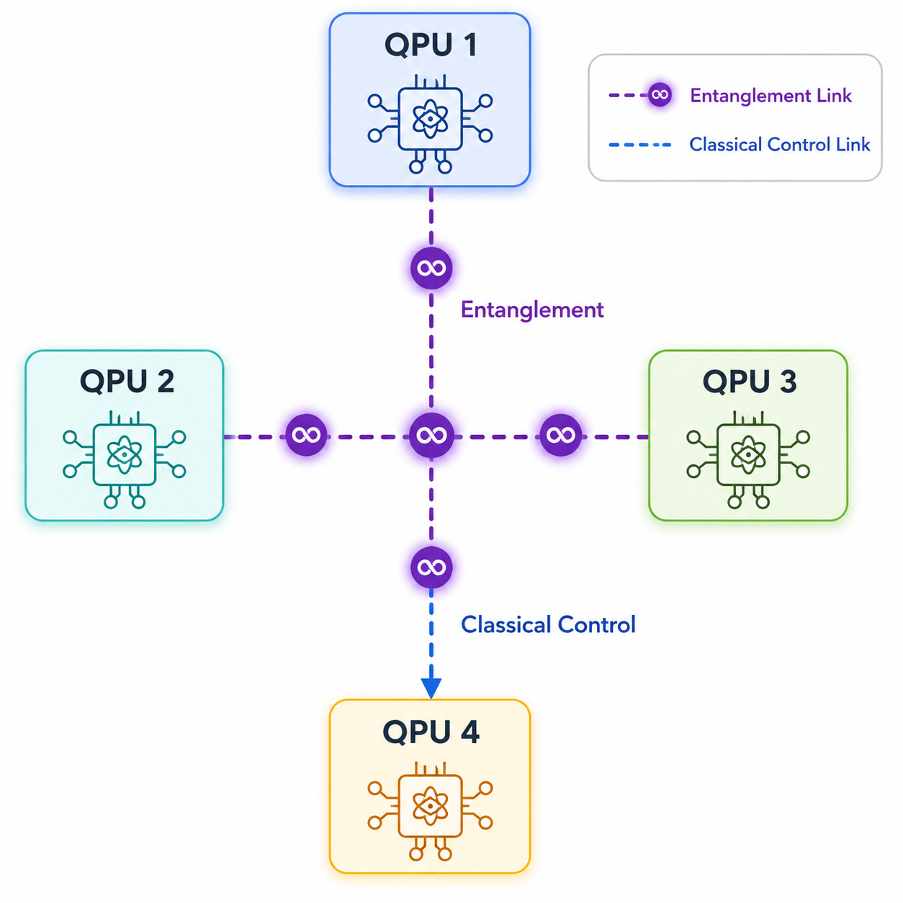
Motivation
Why Study Communication in Distributed Quantum Computing?
The Scalability Challenge - As quantum computers grow beyond the NISQ era, monolithic architectures face significant limitations in connectivity, control complexity, and wiring overhead. Distributed Quantum Computing (DQC) addresses this challenge by interconnecting multiple Quantum Processing Units (QPUs) through quantum communication links.
Communication Requirements in DQC -
Entanglement generation between remote QPUs
Teleported quantum gate operations
Inter-QPU quantum state transfer
Classical synchronization and control
Despite the computational advantages of modular architectures, communication introduces entanglement latency , routing overhead , queue congestion and resource contention
Research Goal
To understand how communication optimization through fast interconnects, intelligent routing, and multiplexed communication can improve the scalability of distributed quantum computing architectures.

Slide 2
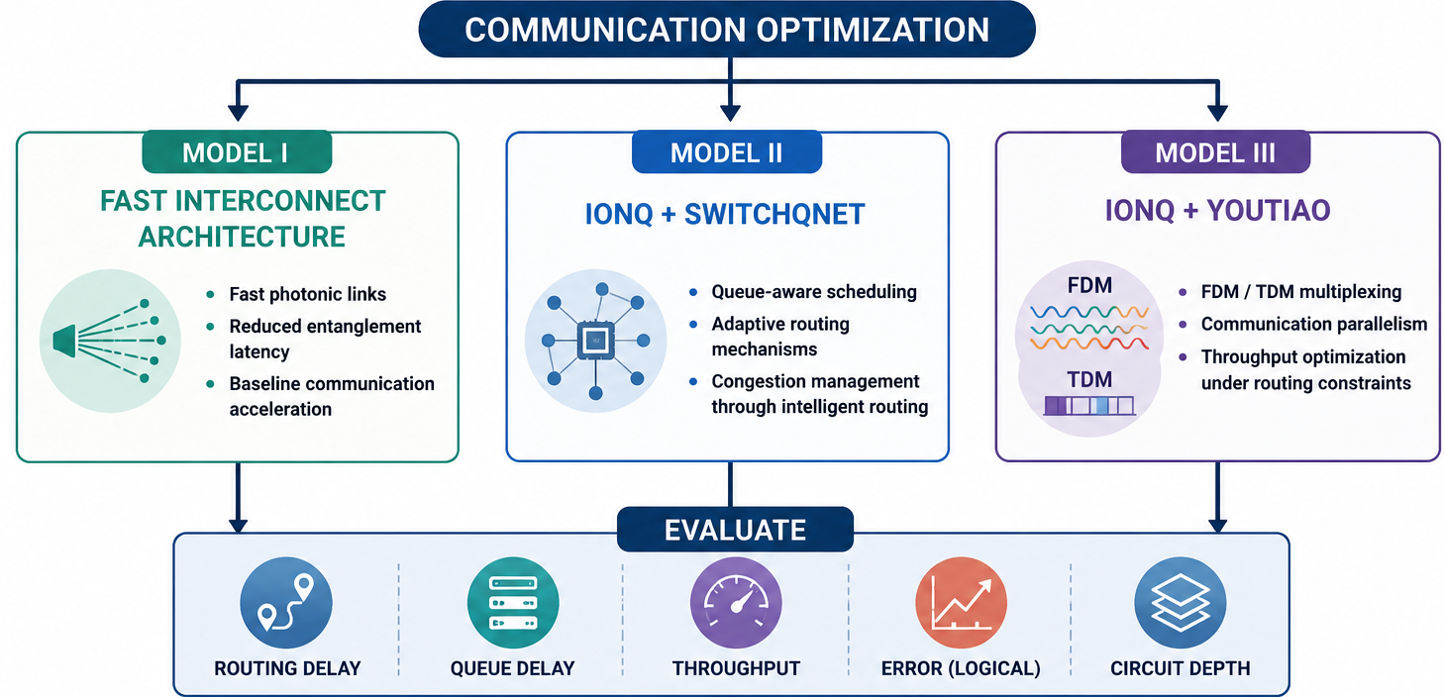
Weekly Objective
Model I — Fast Interconnect Distributed Architecture​
Fast photonic communication links ​
Reduced effective entanglement latency ​
Baseline communication acceleration ​
Model II — IonQ + SwitchQNet​
Queue-aware communication scheduling ​
Adaptive routing mechanisms ​
Congestion management through intelligent routing ​
Evaluation Metrics​
Routing Delay ​
Effective Entanglement Latency ​
Queue Stability ​
Communication Throughput ​
Logical Error Rate ​
Circuit Depth
Model III — IonQ + YOUTIAO​
FDM/TDM multiplexed communication ​
Communication parallelism ​
Throughput optimization under routing constraints

Slide 3
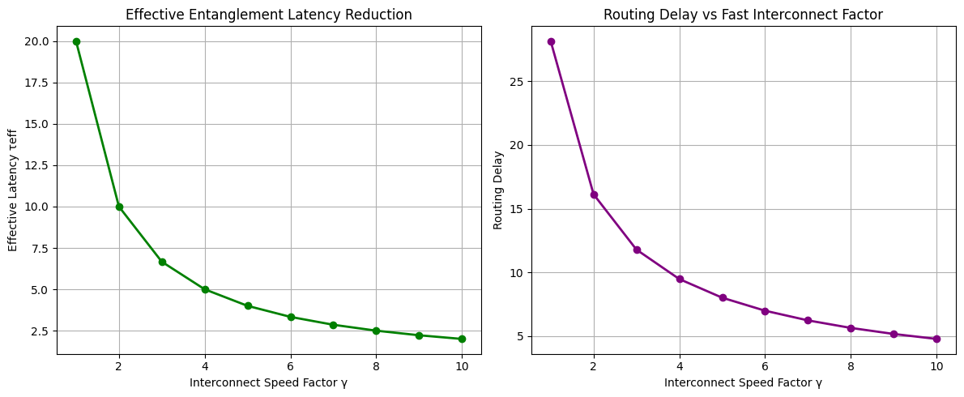
Model I: Fast Interconnect Distributed Architecture
The model evaluates if fast photonic interconnects can improve communication efficiency and stabilize distributed execution.
As the interconnect speed factor (γ) increases:
Effective entanglement latency decreases rapidly
Routing delay decreases significantly
Synchronization overhead is reduced
Communication serialization is minimized
Distributed execution becomes more stable
Effective Entanglement Latency Reduction
Effective latency drops sharply with increasing γ
Fast photonic communication suppresses long-distance communication overhead
Latency approaches a lower bound at higher interconnect speeds
Routing Delay vs Interconnect Speed (γ)
Routing delay decreases dramatically as communication becomes faster
Synchronization waiting time is significantly reduced
Routing instability originates primarily from communication latency rather than computation

Slide 4
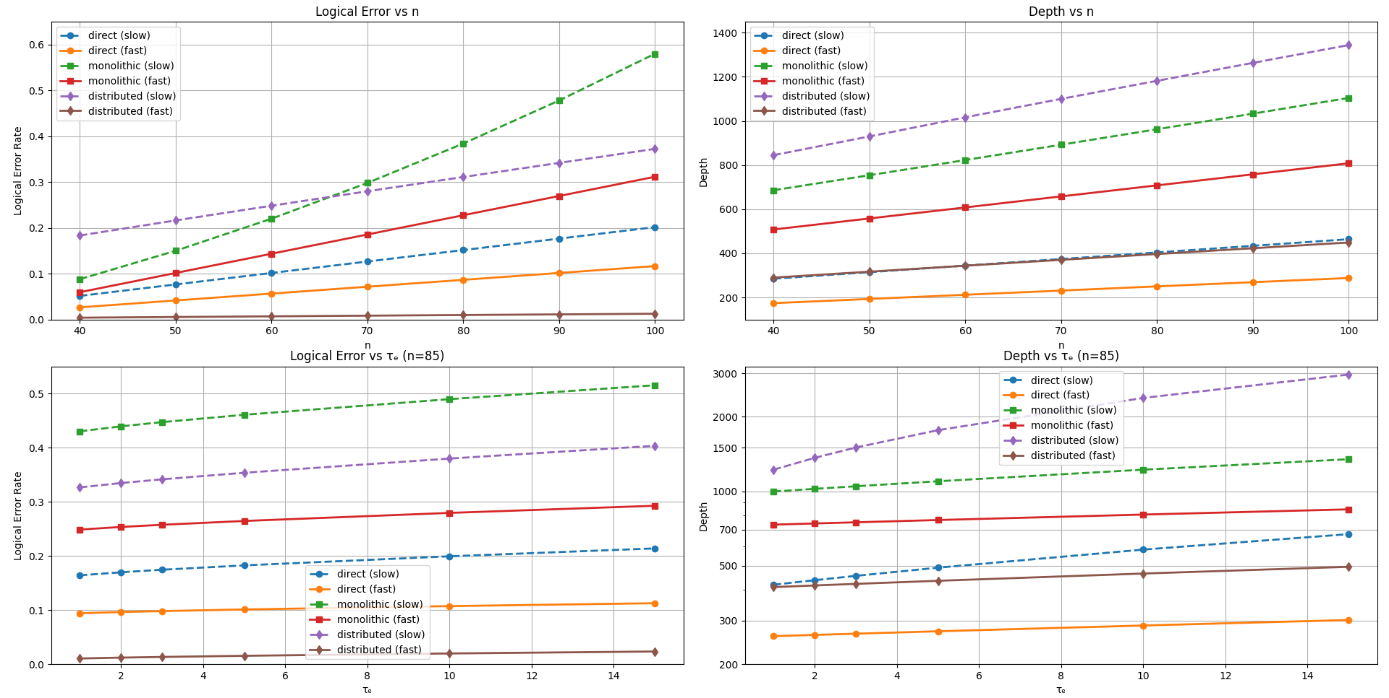
Model I Results
Logical Error vs System Size
Fast interconnect distributed systems exhibit substantially lower logical error than slow distributed systems. Reduced communication latency suppresses routing-induced decoherence.
Depth vs System Size
Slow interconnect depth grows rapidly. Fast interconnect depth remains significantly lower.
Logical Error vs Entanglement Latency
Slow distributed systems show stronger error sensitivity to latency. Fast interconnect systems stay comparatively stable. Fast photonic links effectively isolate the system from communication-induced noise accumulation.
Depth vs Entanglement Latency
Slow distributed systems exhibit severe depth explosion. Fast interconnect systems maintain bounded depth growth. Fast communication stabilizes distributed execution and prevents synchronization collapse.

Slide 5
Model II: IonQ + SwitchQNet + Fast Interconnect
IonQ Contribution
Modular distributed QPU architecture
Hardware-aware communication model
Realistic entanglement latency
SwitchQNet Contribution
RL-inspired routing priority
Queue-aware scheduling
Congestion-aware communication management
Fast Interconnect Contribution
Reduced Bell-pair generation latency
Faster synchronization between QPUs
Routing Mechanism
Communication requests enter a routing queue
RL-based priority assigns importance to requests
Scheduler allocates routing resources
Queue-aware decisions minimize congestion
Fast interconnect executes communication
Result
Reduced waiting time
Lower queue buildup
Improved routing stability
Better utilization of communication resources

Slide 6
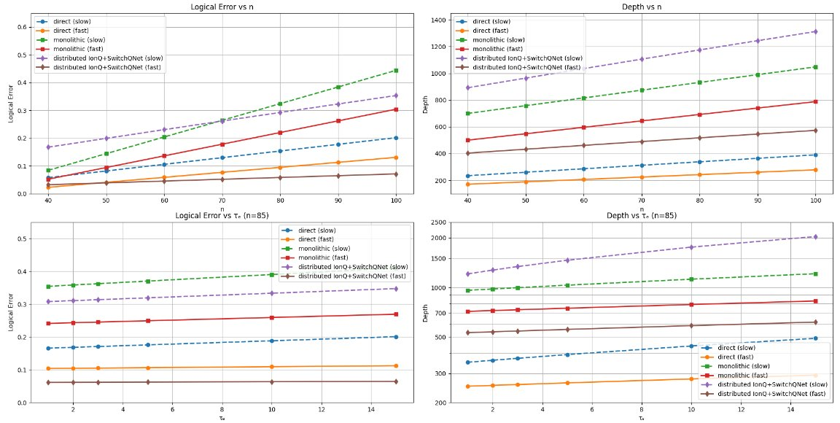
Model III Results
Logical Error vs System Size
RL-assisted fast routing significantly lowers logical error. Slow routing accumulates higher communication overhead. Adaptive scheduling reduces routing congestion and communication decoherence.
Depth vs System Size
Slow routing produces substantial depth inflation. Fast RL-assisted routing maintains moderate growth. Queue-aware scheduling efficiently stabilizes distributed execution depth.
Logical Error vs Entanglement Latency
Slow systems become increasingly error-prone with latency. Fast RL routing suppresses this growth. Adaptive routing improves robustness against communication delay.
Depth vs Entanglement Latency
Slow distributed depth grows strongly. Fast routing significantly suppresses depth accumulation. RL scheduling successfully prevents routing instability.

Slide 7
Model III: Model III: IonQ + YOUTIAO
As distributed quantum systems scale, communication channels become increasingly congested. Simply adding more communication links is not sufficient, as it introduces routing contention, synchronization delays, and control overhead.
YOUTIAO addresses this challenge through communication multiplexing, enabling multiple communication operations to share physical resources more efficiently.
Frequency Division Multiplexing (FDM)
Multiple communication channels operate simultaneously at different frequencies.
Improves communication parallelism.
Reduces channel waiting time.
Time Division Multiplexing (TDM)
Communication operations are scheduled across different time slots.
Improves utilization of available communication resources.
Reduces communication serialization.
Communication Parallelism
Multiple distributed communication requests can be processed concurrently.
Improves effective throughput of the distributed network.
Increase communication throughput while controlling interference, synchronization overhead, and communication latency.
The central idea achieve scalable communication by balancing higher throughput, low routing delay and better resource utilization.

Slide 8
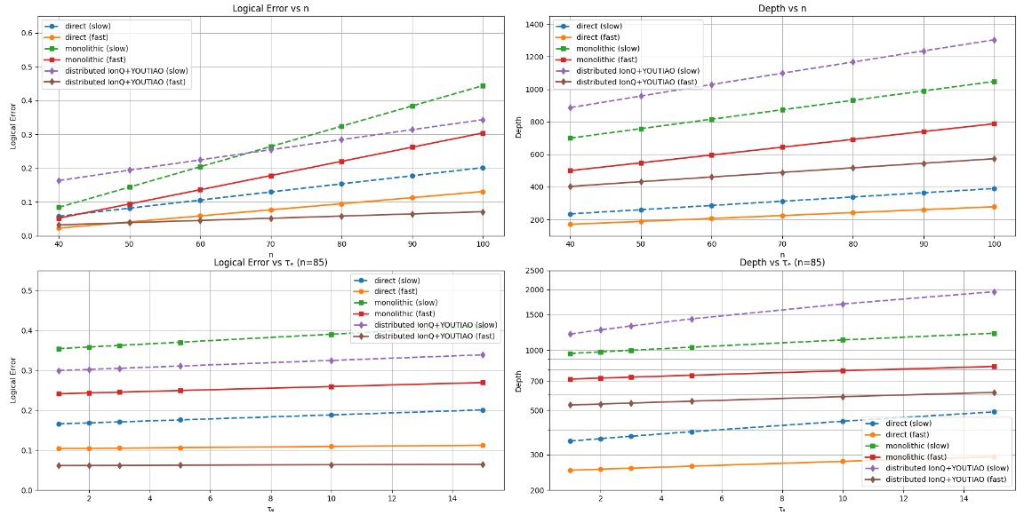
Model II Results
Logical Error vs System Size
Fast multiplexed communication lowers logical error. Slow distributed communication produces larger error growth. Communication optimization reduces synchronization-induced decoherence.
Depth vs System Size
Slow distributed architectures show large depth inflation. Fast multiplexed systems remain comparatively stable. Parallelized communication suppresses distributed execution overhead.
Logical Error vs Entanglement Latency
Fast multiplexed communication maintains relatively stable logical error. Slow communication exhibits stronger sensitivity. FDM/TDM optimization stabilizes latency-sensitive execution.
Depth vs Entanglement Latency
Slow systems experience severe depth escalation. Fast multiplexed communication suppresses depth growth. Communication optimization successfully stabilizes distributed synchronization.

Slide 9
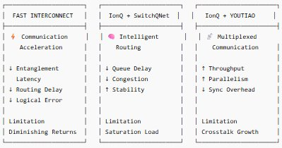
Comparative Results
Fast Interconnect Architecture
Lower logical error rates
Reduced circuit depth
Suppresses latency-induced decoherence
➡ Communication speed directly improves scalability.
IonQ + SwitchQNet
Stable queue growth
Reduced congestion
Adaptive routing prevents communication collapse
➡ Intelligent scheduling transforms communication into a manageable resource.
IonQ + YOUTIAO
Highest routing throughput
Reduced synchronization overhead
Improved communication parallelism
➡ Multiplexing maximizes utilization of communication channels.

Slide 10
Key Takeaway
Communication, Not Computation, Governs Scalability
As quantum gate execution becomes faster, communication overhead—including entanglement generation, routing, and synchronization—emerges as the dominant factor determining system performance.
Multiplexed Communication Improves Throughput but Introduces Physical Tradeoffs
Increasing channel density also amplifies crosstalk, creating a fundamental throughput–interference tradeoff.
Fast Photonic Interconnects Mitigate Latency Induced Instability
Reducing effective entanglement latency significantly suppresses routing delay, synchronization overhead, and communication-induced decoherence, leading to more stable distributed execution.
Scalability Requires Multi-Layer Communication Optimization
Neither fast interconnects, adaptive routing, nor multiplexing alone is sufficient. Scalable distributed quantum computing emerges only when communication is optimized jointly across hardware, routing, and control layers
Adaptive Routing Converts Communication into a Manageable Resource
Queue-aware and RL-inspired scheduling strategies prevent congestion collapse, stabilize routing behavior, and maintain bounded communication complexity even as system size increases.

